Slide 1

Violence In The Land
Ezekiel 6-7

Slide 2
Violence In The Land
Ezekiel 7:11, “Violence is risen up into a rod of wickedness; none of them (shall remain), nor of their multitude, nor of their wealth: neither shall there be eminency among them.”
Ezekiel 7:23, “Make the chain; for the land is full of bloody crimes, and the city is full of violence.”
Ezekiel 8:17, “Then he said unto me, Hast thou seen (this), O son of man? Is it a light thing to the house of Judah that they commit the abominations which they commit here? for they have filled the land with violence, and have turned again to provoke me to anger: and, lo, they put the branch to their nose.”

Slide 3
Violence In The Land
The Lord states, “Now is the end upon thee …” in reference to the people’s punishment. (Ezekiel 7:3)
This was a day of “tumult.” (Ezekiel 7:7)
A day when God’s sinful people would “loath themselves in their own sight for the evils which they have committed.” (Ezekiel 6:9b)
A day of God’s “anger” and “wrath.”
(Ezekiel 7:8)
A day of “horror and shame.” (Ezekiel 7:18)

Slide 4
The Devastation of the Land
Ezekiel 6-7
Destruction is decreed upon the land. 6:1-7
  The slain would not even be given the dignity of a burial. Micah 6:2; Jeremiah 8:1-3
  The Effect: “Ye shall know that I am the Lord!”
A remnant will be spared. 6:8-10
The punishment is just. 6:11-14

Slide 5
The Devastation of the Land
Ezekiel 6-7
The certainty of the judgment. 7:1-9
  Ezekiel 7:5-6, “Thus saith the Lord Jehovah: An evil, an only evil; behold, it cometh. An end is come, the end is come; it awaketh against thee; behold, it cometh.”

Slide 6
The Devastation of the Land
Ezekiel 6-7
The desolation is described. 7:10-27
  Social disruption. 7:10-13
  Military disruption. 7:14-18
  Economic disruption. 7:19-22
  Political disruption. 7:23-27

Slide 7
The Devastation of the Land
Ezekiel 6-7
APPLICATION:
Ezekiel 7:4 – Though God is full of mercy, our rebellion in sin can reach the point of no return and the Lord will have no “pity” … i.e.
  He will not spare the wicked in the day of punishment. cf. 2 Chronicles 36:15-18; Revelation 14:9-11

Slide 8
The Devastation of the Land
Ezekiel 6-7
APPLICATION:
Ezekiel 6:7, 10, 13, 14; 7:4, 9, 17, “Ye shall know that I am the Lord” does not mean that every single individual knows Jehovah, but all over the world the testimony of history of this world is that God rules and His principles cannot be flaunted.
Habbakkuk 2:14; Romans 1:19-20

Slide 9
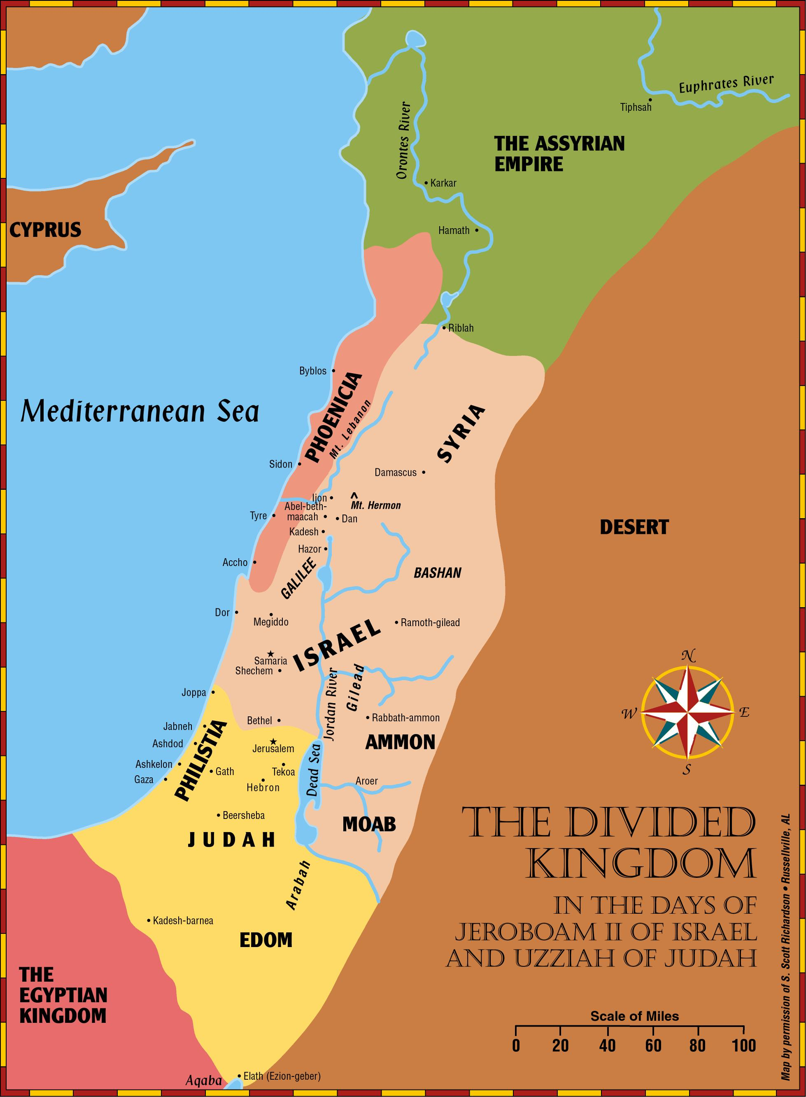

Slide 10
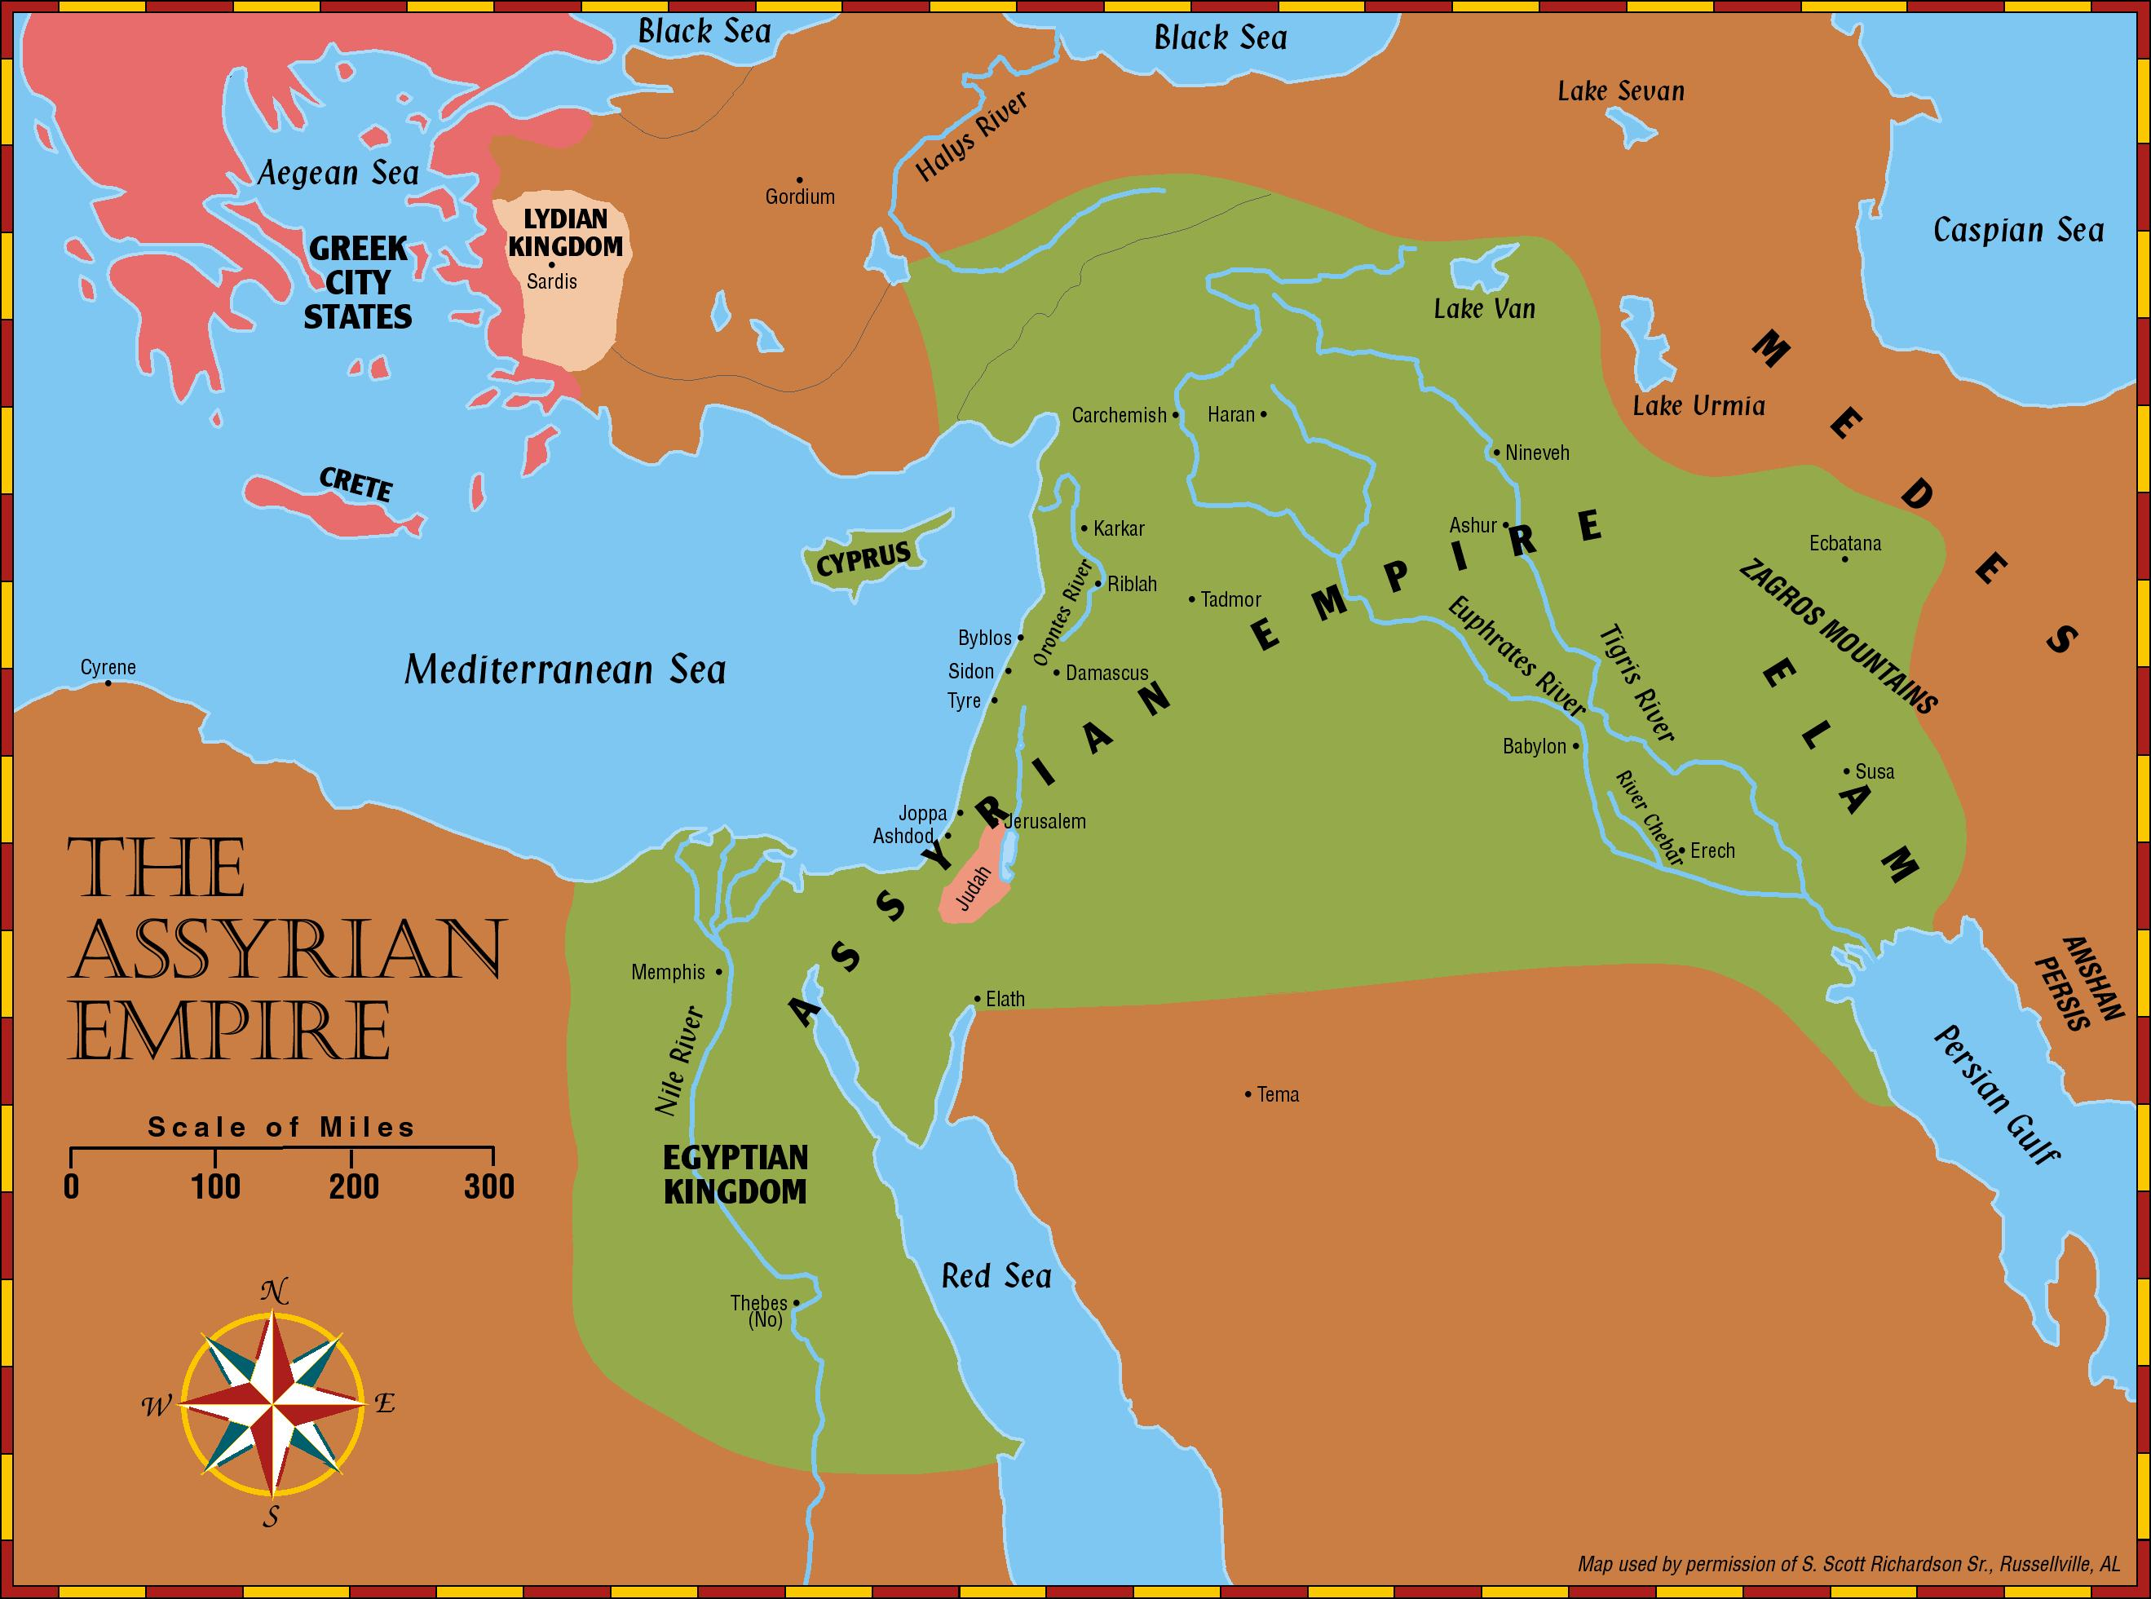

Slide 11
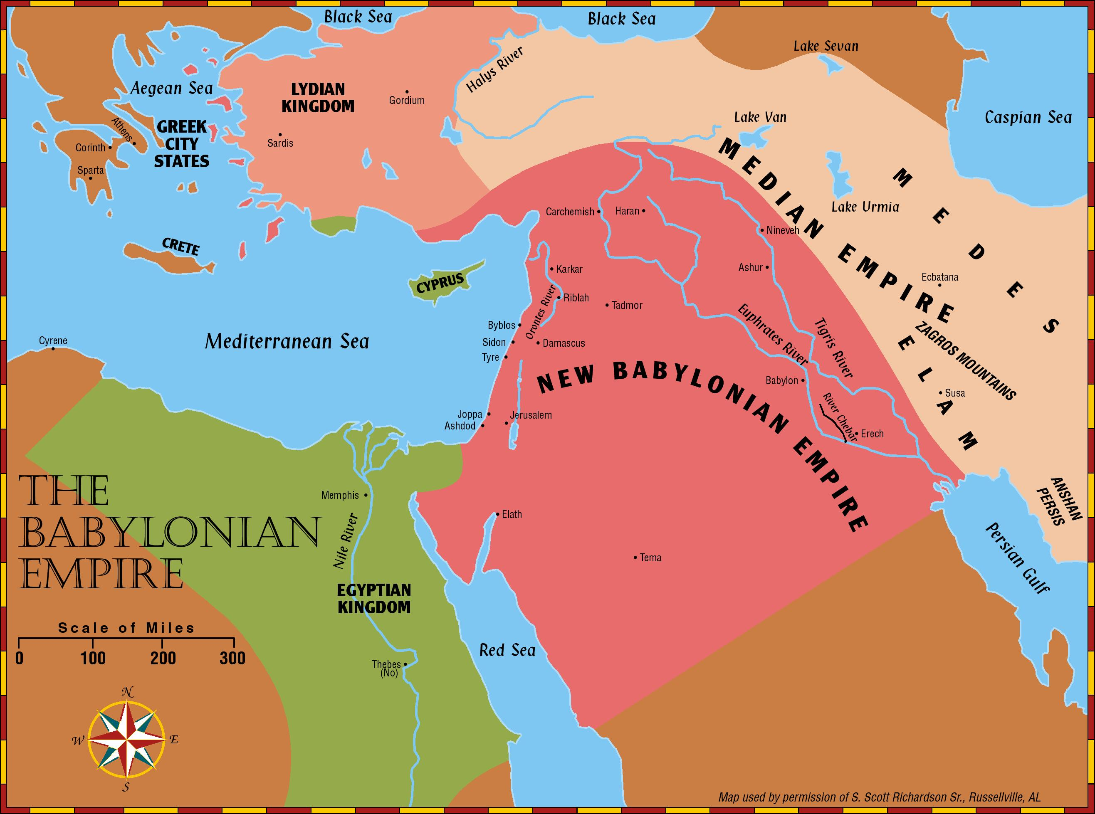

Slide 12
